Slide 1
HEALTH MONITORING SYSTEM
Done by
MANICKAM . S
Registration No.:912321104023
SACS MAVMM Engg College - Madurai

Slide 2
PROJECT AGENDA;
Problem statement
Proposed system/solution
System development approach
Algorithm and deployment
Result
conclusion

Slide 3
Problem statement
Remote health monitoring can provide useful physiological information in the home.This monitoring is useful for elderly or chronically ill patients who would like to avoid a long hospital stay.Wireless sensors are used to collect and transmit signals of interest and a processor is programmed to receive and automatically analyze the sensor signals. In this project, you are to choose appropriate sensors according to what you would like to detect and design algorithms to realize your detection. Examples are the detection of a fall, monitoring cardiac signals. Using a single parameter monitoring system an approach to a remote health monitoring systemwas designed that extends healthcare from the traditional clinic or hospital setting to the patient's home. The system was to collect a heartbeat detection system data, fall detection system data, temperature data and few other parameters. The data from the single parameter monitoring systems was then availed for remote detection.

Slide 4
Proposed system/solution
Design a Remote Patient Health Monitoring System (RPHMS) which has heartbeat detection system, a fall detection system, temperature detection system, a humidity detection system, a toxic gas and air quality detection system and SPO2 detection system. A doctor or health specialist can use the system to monitor remotely of all vital health parameters of the patient or person of interest. An attempt at designing a remote healthcare system made with locally available components.
The fall detector, temperature, humidity, pressure, toxic gas, air quality control, SPO2 modules comprise of an accelerometer, wireless transmitter and microcontroller.
The data collected was transmitted wirelessly to a receiver module.
ii) ECG consists of a non-invasive infrared finger detector, Liquid Crystal Display (LCD)
iii) designed circuit for cardiac signal detection and microcontroller. The detected analog signal was then digitized to give a digital value that was read on the LCD.
iv) A simple cloud server where hosted with a database for all the vital data to be accessed remotely whenever required.

Slide 5
Proposed system(contd…)
The main objective is to design a Patient Monitoring System with two-way communication i.e. not only the patient’s data will be sent to the doctor through SMS and email
on emergencies, but also the doctor can send required suggestions to the patient or guardians through SMS or Call .Our project is comprised of both hardware and software. In hardware part, heartbeat sensor is used.
Therefore Arduino uno integrates with the WIFI Module. When the heartbeat and temperature is measured, WIFI module helps to upload it in cloud as message, Web and APP server. Moreover GSM modem sends

Slide 6
System development approach
In our proposed system we monitor the patient condition especially for the ICU or cardiac patients but in the future we will upgrade both hardware and software part.
In hardware part, we will measure temperature of the patient so for this we will need temperature sensor.
Also we will monitor the whole ward room or patient room from far places by Wi-Fi module.
Therefore, person fall detection feature will be added which would be beneficial to older people Moreover, blood pressure sensor will be given.
In software segment we will upgrade the Website as well as the Apps.
We will build a user friendly feature in the website which will show the patient name, date and time description in the ECG the heartbeat condition if abnormal too

Slide 7
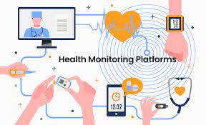
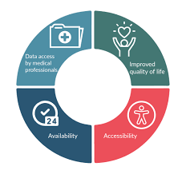
Algorithm and deployment
The main objective is to design a Patient Monitoring System with two-way communication i.e. not only the patient’s data will be sent to the doctor through SMS and email on emergencies, but also the doctor can send required suggestions to the patient or guardians through SMS or Call .
Our project is comprised of both hardware and software. In hardware part, heartbeat sensor is used. Therefore, the heartbeat condition if abnormal too.

Slide 8
Algorithm and deployment (contd…)
Once a set of Super Alarm patterns are identified, these patterns can be deployed to monitor data streams from patient monitors and EHR system so that the arrival of a new data sample triggers a pattern-matching process to detect if any Super Alarm patterns emerge.
If a Super Alarm pattern is detected, a corresponding Super Alarm trigger will be generated. Continuing this process generates a sequence of Super Alarm triggers
. However, it is not optimal to use individual Super Alarm trigger to alert clinicians.
Super Alarm patterns can be redundant, for example, a pattern consisting of heart rate >120 bpm and mean arterial blood pressure (ABP) >110 mmHg is a synonym to a Super Alarm pattern consisting of tachycardia and mean ABP >110 mmHg.
Furthermore, a patient condition of interest may progress at a pace that outruns the temporal scale of individual Super Alarm patterns.
For example, some etiologies behind cardiopulmonary arrest may take hours to develop and hence its prediction needs to accumulate information from time points that lag the current time.

Slide 9
.
Algorithm and deployment(contd…)
The fourth algorithm element, therefore, is to develop pattern recognition approaches to process sequences of Super Alarm triggers.
To analyze a sequence of Super Alarm triggers, one draws an analogy between a sequence of Super Alarm riggers with a text document where each Super Alarm pattern could be considered as a unique word.
Therefore, the analysis of sequences of Super Alarm triggers could leverage all the classical as well as more recently developed statistical text analysis approaches.
Because these sequence analysis approaches can be also applied to sequence of raw alarms, one could question the need of identifying Super Alarm patterns.

Slide 10
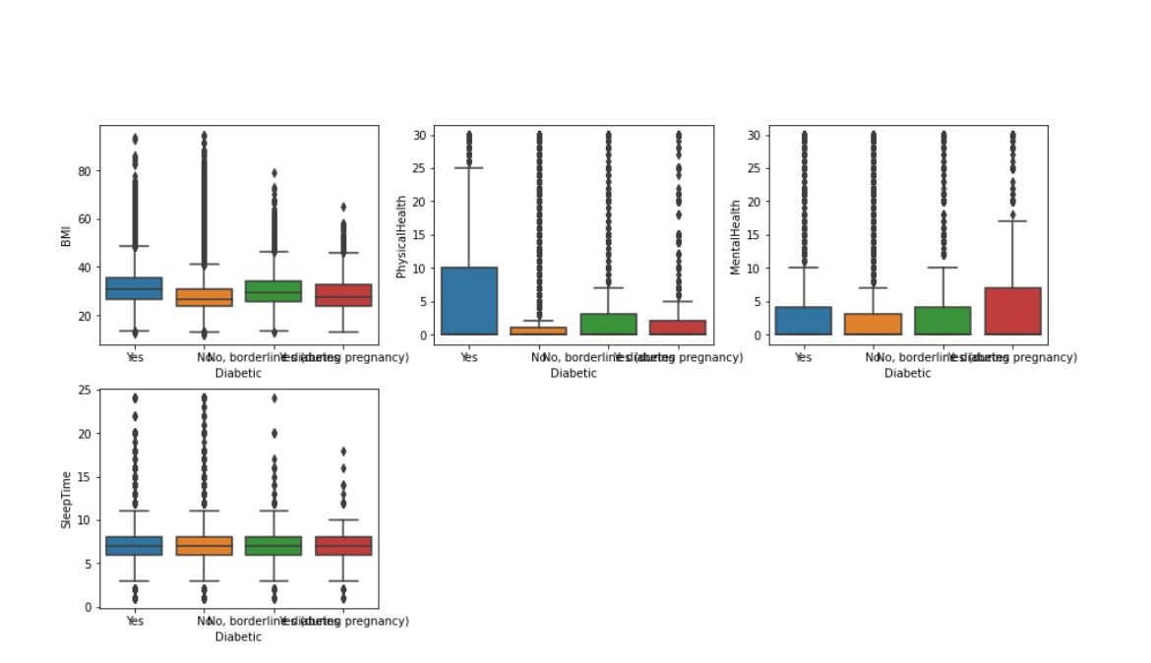
RESULT

Slide 11
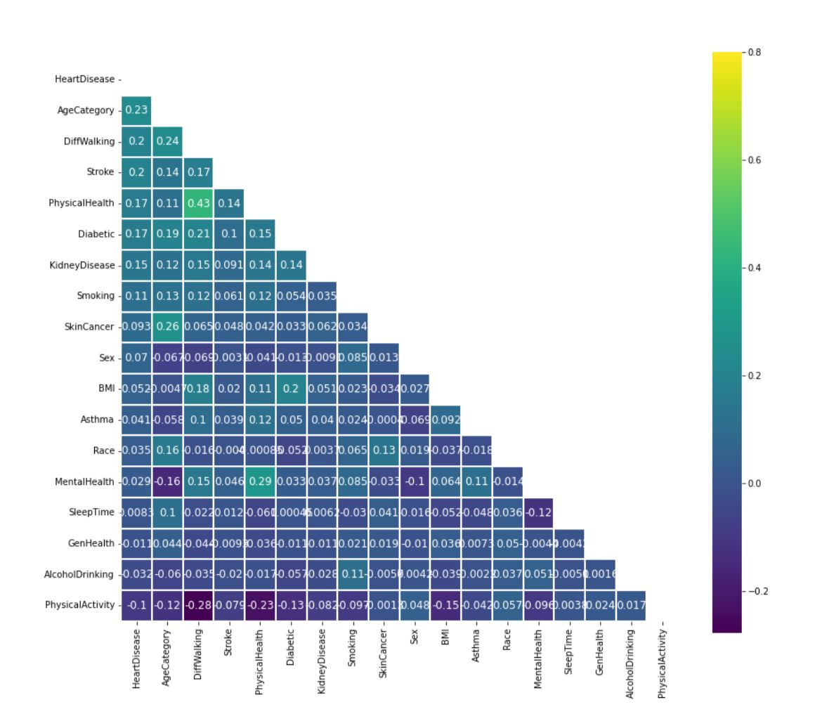

Slide 12
conclusion
opportunity to monitor patient heart beat and temperature continuously by using the web and apps service along with live monitor and if abnormal it sends as message or calls through gsm service. This paper also compared the early aged medical system between present time health monitoring. The present time represents the time reducing, reduce health care cost especially for rural area people. segment automatically. Similarly, Apps will be upgraded and uploaded in the Play store. Therefore, people will get the opportunity to download the Apps from Google Play Store and install it in their Page as phone. Due to the importance of observing medical state of patients who are suffering from acute diseases, especially cardiovascular diseases, a continuous remote patient monitoring is essential. Internet of Things is able to provide tools to build comprehensive services.

Slide 13
Reference
https://numpy.org/
https://pandas.pydata.org/
https://matplotlib.org/
http://seaborn.org/
Datset link
http://kaggle kernels output georgyzubkov/heart-disease-exploratory-data-analysis –p /path/to/dest/

Slide 14
.
THANK YOU

